Slide 1
CETAL PW
September 2016

Slide 2
CETAL-PW , JUNE STATUS
Front-end recovered after component (wave-plate, booster cristal rod, etc) and consumable parts replacement (flash lamp)
3 ATLAS rods broken → scheduled for replacement
3 ATLAS rods became opaque → shipped for repolishing
2 damaged beam-transport mirrors → to be repaired
1 semi-damaged beam-line mirror → to be repaired or replaced

Slide 3
CETAL-PW , JULY STATUS
Thales installed two new ATLAS rods, thus fully recovering one of the pumping lasers
SAGA power supply malfunction due to electronic power card failure → repaired in CETAL workshop
2 beam-line system mirrors shipped to ARDOP for reconditioning
One gold mirror and one substrate for new dielectric mirror ordered from ARDOP
Three ATLAS rods sent to ALTECHNA for repolishing. Expected delivery time: early October

Slide 4
CETAL-PW, SEPTEMBER STATUS
Design and implementation of a versatile monitoring system for CETAL-PW beam line alignment
Design and installation of a mechanical system to ease access to the M3 and M4 mirrors
Thales is installing one new ATLAS rod at one of the pumping lasers
Design of a complementary system for optical setup alignment, based on a fiber coupled laser diode module.
Identification of an exfoliated compressor mirror → mitigation procedure implemented

Slide 5
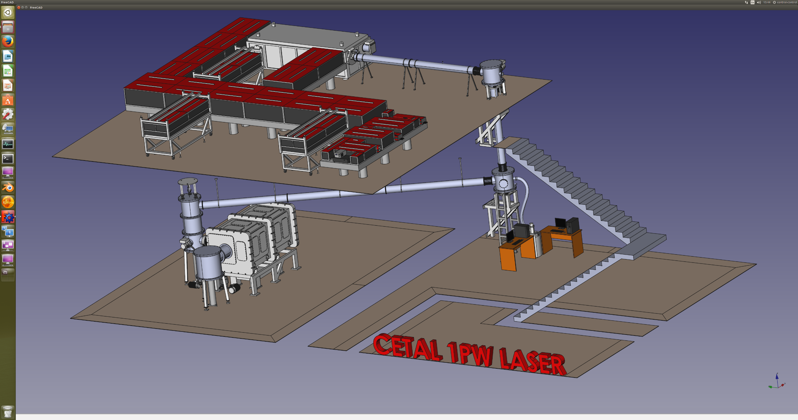
Design of
CETAL – PW
laser system

Slide 6
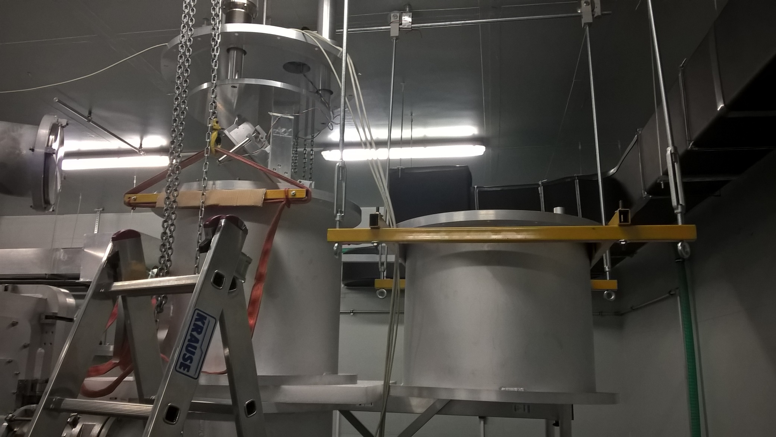
M3, M4 mirrors new easy access system under implementation

Slide 7
CETAL – Beam line system
Compressor
M1
NF
CCD USB
M3
M2
NF
CCD USB
M4
Interaction chamber
NF
CCD
FF
NF
CCD USB
CCD

Slide 8
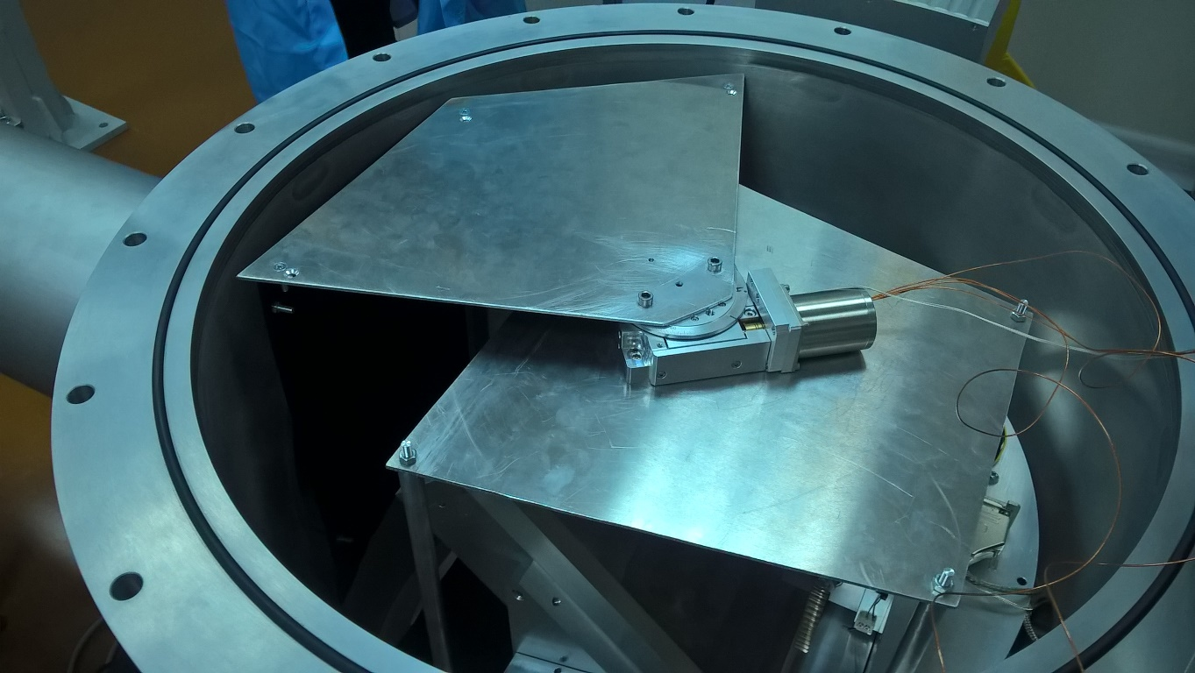
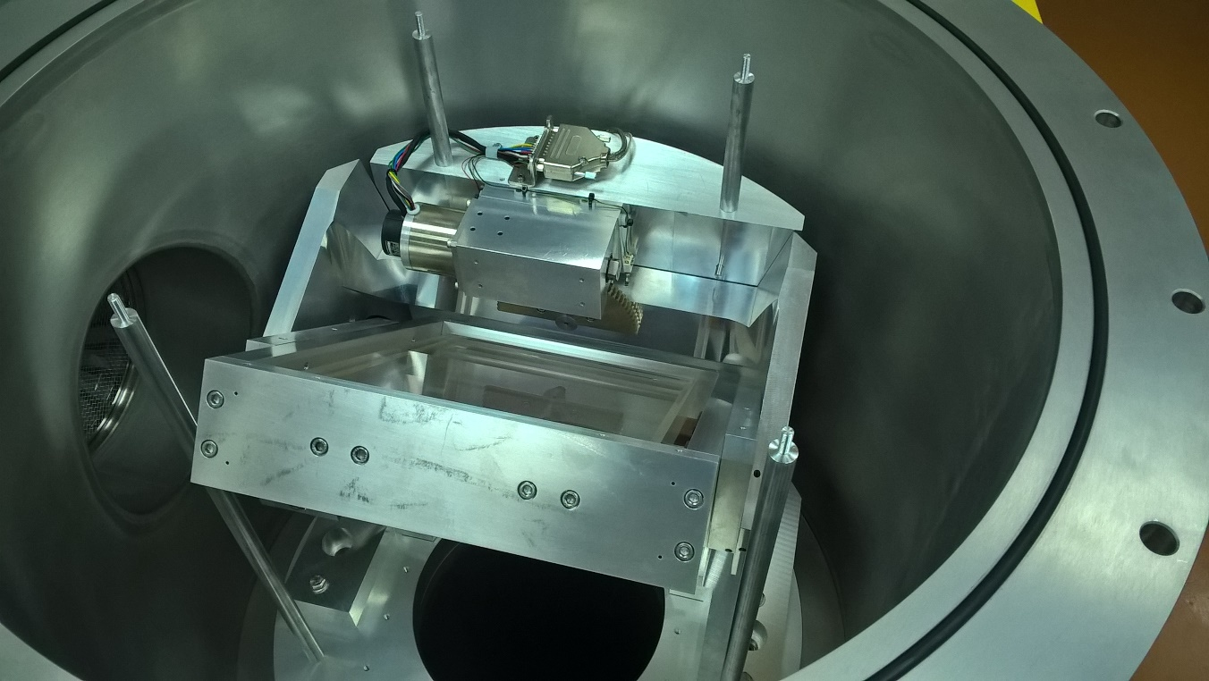
M1 – new control system implemented

Slide 9
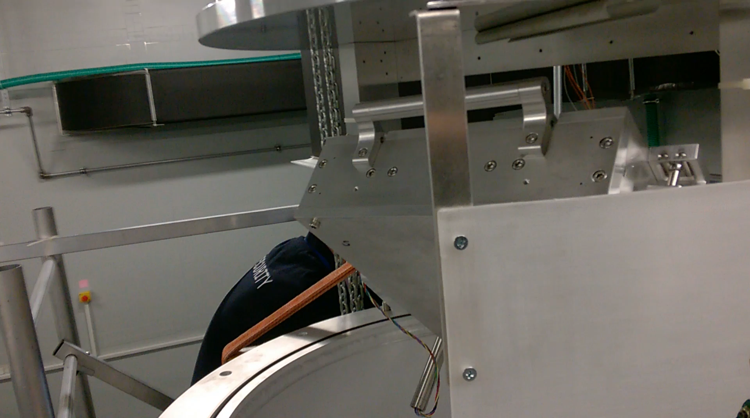
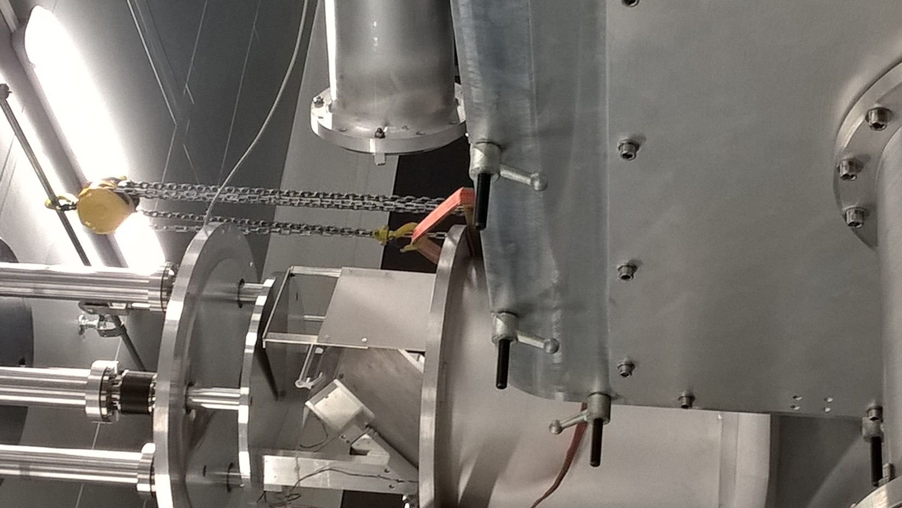
M3 – new control system under implementation

Slide 10
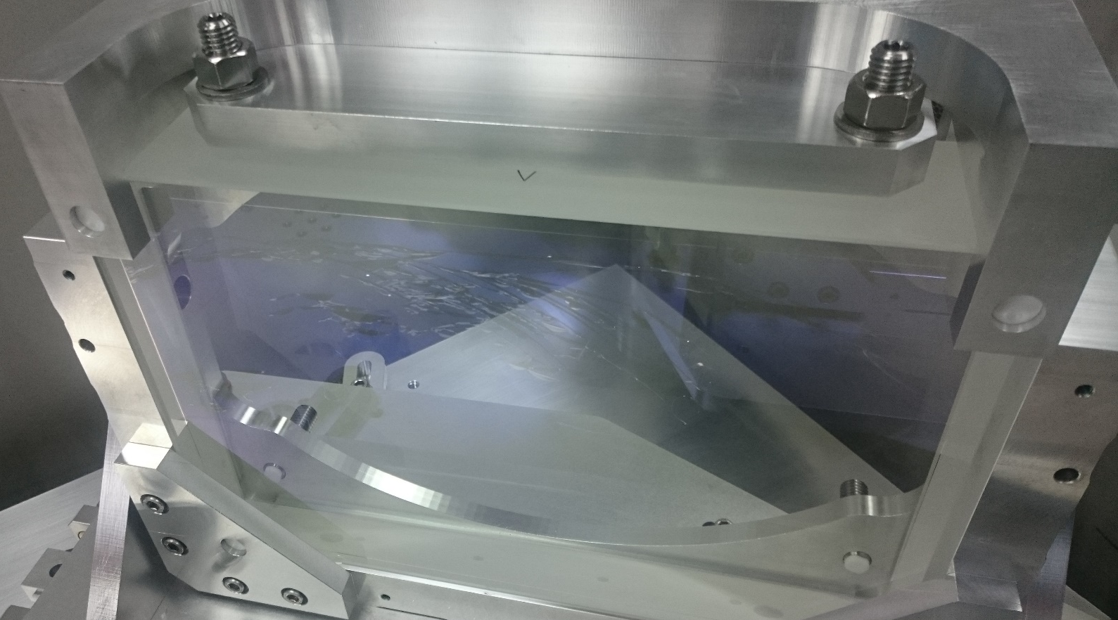
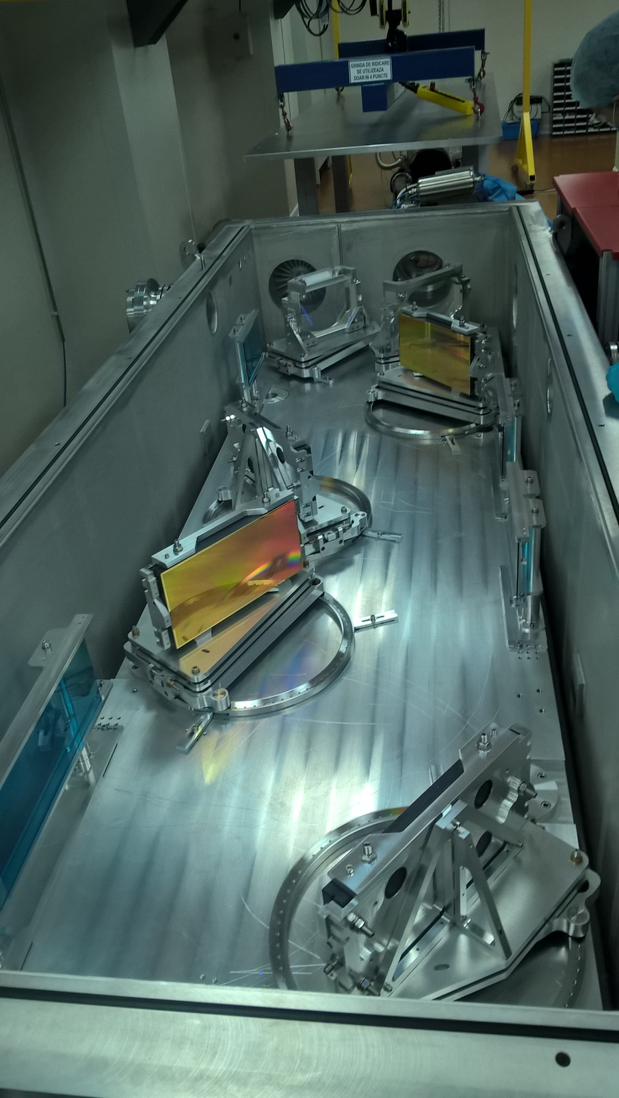
Damaged compressor mirror

Slide 11
CETAL-PW, next steps
Install repolished rods at ATLAS lasers
Send exfoliated mirror to Thales for reconditioning. Thales will assure a replacement mirror, for temporary use.
Restart experiments with slow increasing energy. Start with 5 J (~100TW) of power, scheduled to reach 25 J (~1PW) in May - July 2017.
In 2017, two beam-line dielectric mirrors scheduled for repair and two new substrates to be ordered from ARDOP. Upon delivery, all beam line mirrors will have spare parts
In 2017, 3 new rods for the ATLAS pumping lasers will be ordered

